Slide 1
Alojz Gomola
Obstacle avoidance based on Reach Sets
15th January 2018
Short story how to keep your UAV safe

Slide 2
What I am going to Talk about
Easy introduction to Obstacle Avoidance
Follow Lojzo on his journey to Pub
Obstacle Avoidance challenges related to Everyday situation
Obstacle avoidance framework
Brief introduction to obstacle avoidance framework
What are components how they work together ?
Some results
Framework performance comparison with other methods
Intruder avoidance (Reactive level)
Static obstacle avoidance (Reactive level)
Actual challenges
Weather incorporation into obstacle avoidance, Rules of the Air

Slide 3
Global research topic
Obstacle avoidance for UAV/UAS/RPAS systems:
Given:
partially known world, changing weather, information sources
mission plan,
small UAV equipped with a LiDAR and ADS-B sensors
Safe and robust approach to real-time reactive obstacle avoidance
small computational footprint
guarantees safe path
guarantees turn return checkpoint
Main applications:
terrain avoidance for low altitude flights
avoidance of intruders

Slide 4

Easy introduction to Obstacle Avoidance

Slide 5
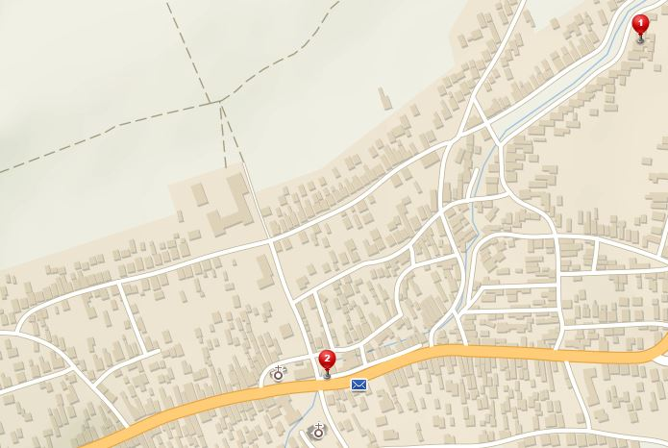
How to get to a pub ?
I am at Home and I want to get to a PUB
Home
Pub

Slide 6
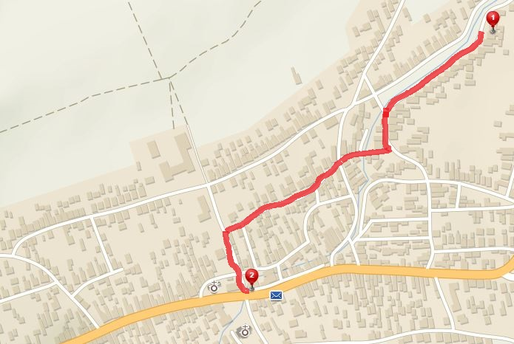
No problem, I know a map of my surroundings
[1] Path planning problem:
1. Get map of surrounding area
2. Find shortest path between waypoints
Use of safe routes Optional
Path to PUB

Slide 7
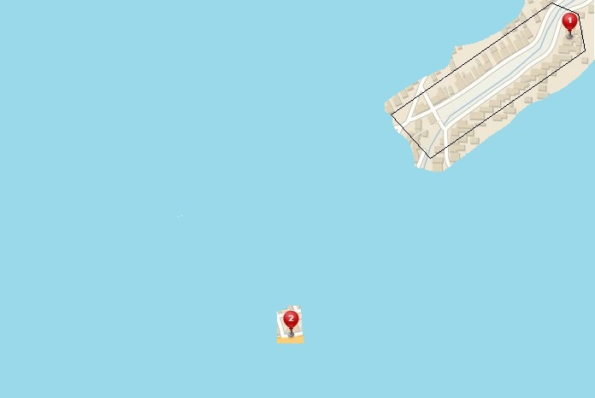
Forget your map, know PUB location
You are in front of your Home
You can sense some of your surroundings
(Field of Vision)
[2] Evolving world:
1. You are obtaining more knowledge as you move
2. You need to make Decisions when you reach your FOV boundary
You know where is PUB
(GPS)

Slide 8
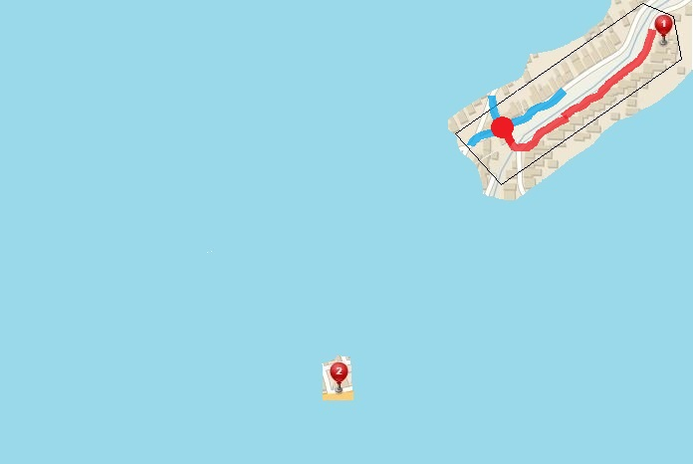
I get to the first intersection, now what ?
Way 3
Way 2
Way 1
Decision point
[2] Evolving world:
Decision Point – point of safe return (I can go home), where I do new sensor scan and decide follow up trajectory
Passed trajectory
You know where is PUB
(GPS)
You will probably apply some sort of COST FUNCTION in your decision

Slide 9
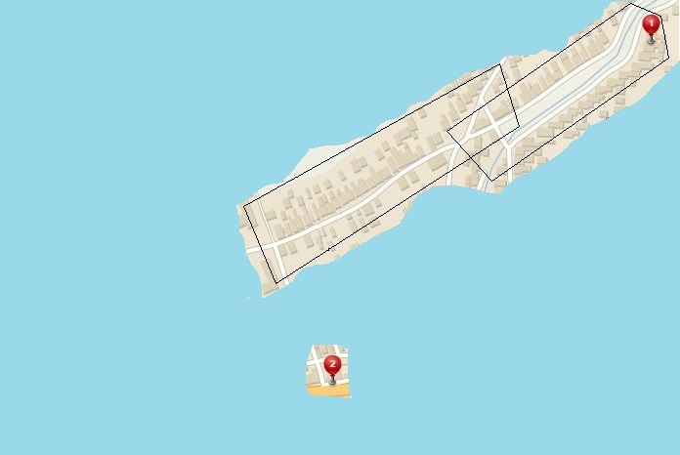
Look around, get know to your surroundings
This patch can get me closer to PUB,
(Other sightings NOT so useful)
[2] Evolving world:
Known World – Pieces of observations which are useful for the mission goal, you can define own set management, based on performance requirements
You know where is PUB
(GPS)

Slide 10
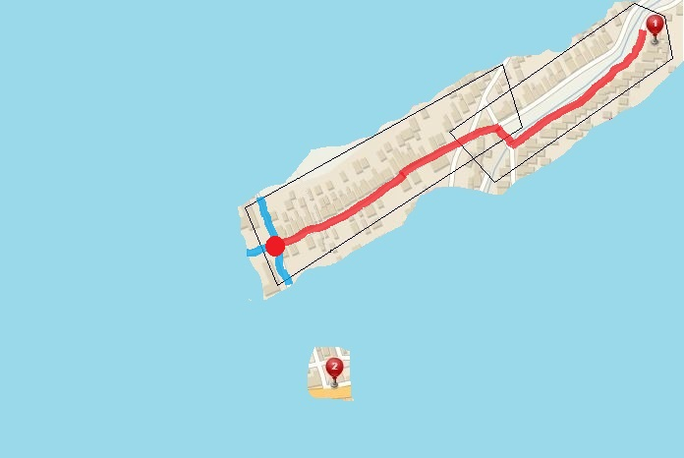
Walk a little more, get closer to PUB
[2] Evolving world:
Rinse and repeat the previous strategy
Way 3
Passed trajectory
Way 2
Decision point
Way 1
You know where is PUB
(GPS)

Slide 11
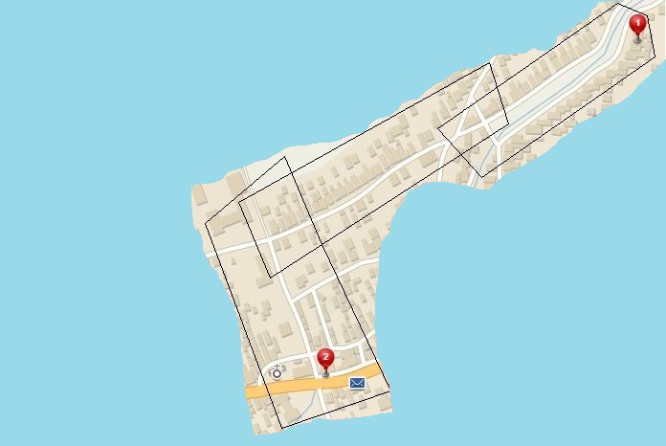
Now I can see the PUB
[2] Evolving world:
Now just walk down to the street and get to a PUB
You know where is PUB
(GPS)
I can see free way to PUB
(Other sightings are scrapped)

Slide 12
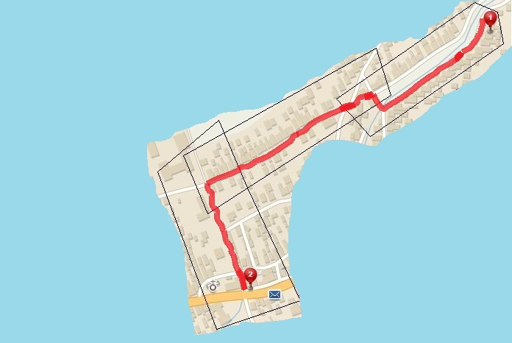
I can finally enjoy the Cola with my friends
[2] Evolving world:
Optimal paths in given FOVs
Evolving world cause suboptimal paths
(Note that path is different)
You know where is PUB
(GPS)

Slide 13

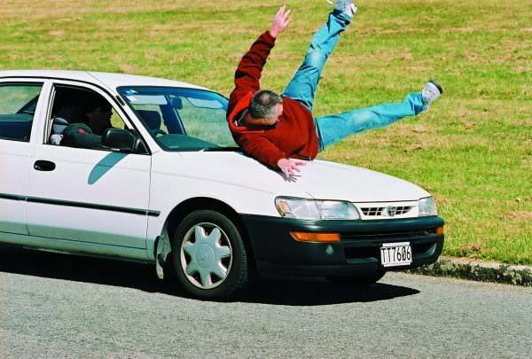
You are NOT alone on the streets !
[3] Adversarial:
While you are moving to PUB you need to be cautious about:
Cars and Other people
Because hitting them can cause damage to you or other people or property
[3] Adversarial:
You need to implement:
Reactive obstacle avoidance
You can assume:
Position of Adversary
Its Velocity vector
Own position and velocity

Slide 14


Multiple source of information – Data Fusion
[4] Data fusion:
You are well prepared, you ask locals, you got map, you can see a world, but to make decision you need to process that information:
Data Fusion
Is there to help
[4] Data Fusion:
You need to implement:
Decisions under uncertainty
Determine what is truth
Consider all information
Rank your sources worth

Slide 15
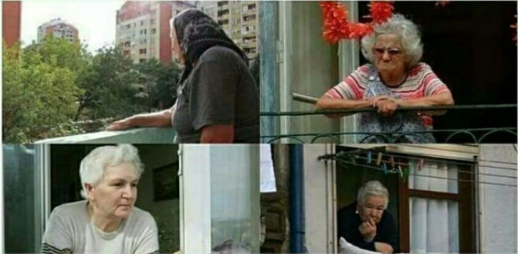

Gopniks & Babushkas – Static restriction areas
[5] Static restrictions:
Well there are inhabited areas which you like to avoid, like Gopnik Squat Area where you can be beaten or Local Surveillance system which will tell your grand mother
[5] Static restrictions:
Breakable – You can tell your grand mother you were on your way to local church
Unbreakable - Gopniks will beat you anyway
Try to avoid all restricted areas

Slide 16
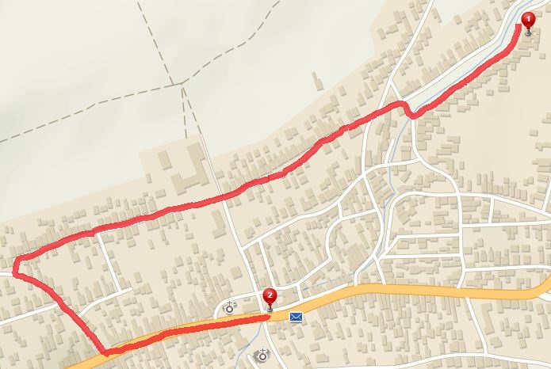
Try to avoid static restrictions areas !
[5] Static restrictions:
Try to avoid them (KW evolution omitted)
Gopnik Squat Area – unbreakable, must avoid
Babushkas – breakable, but you have no excuse
Gopnik Squat Area
Babushka Vigilante Groups

Slide 17


How about weather ?
[6] Weather:
Slav winter cold harsh mistress,
If you don’t treat her well she will strike with sickness for 7 days
[6] Weather:
Weather can impact energy consumption
Weather is changing with time
Decision making with additional layer
Impact on your eyes and ears

Slide 18
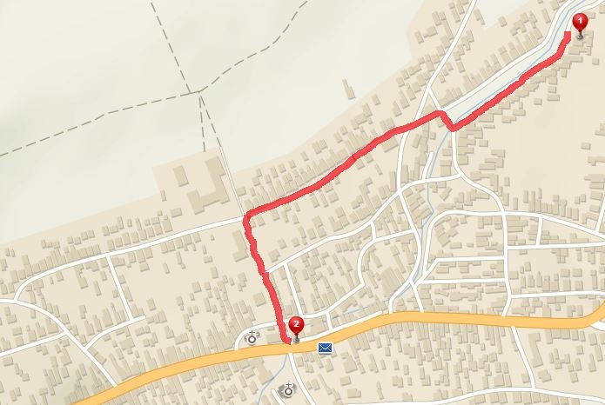

Rather get caught, than catching cold …
[6] Weather:
Try to avoid unfavorable weather conditions:
Heatwave at EAST (changing with time)
Snowstorm at WEST (changing with time)
Snowstorm
I will explain somehow…
Gopnik Squat Area
Heatwave
Babushka Vigilante Groups

Slide 19
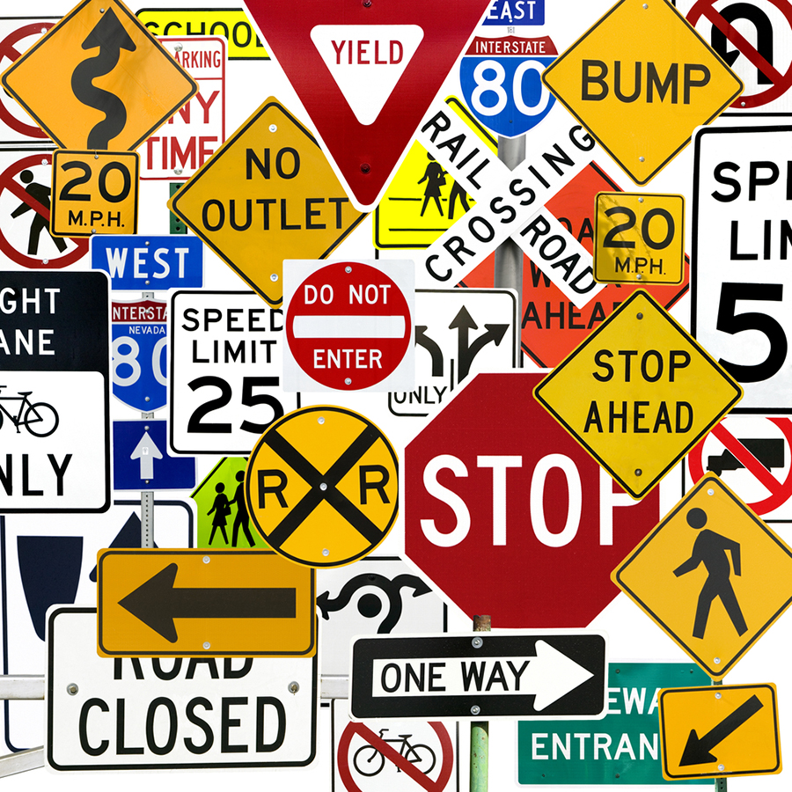
Keep good manners !
[7] Rules:
Keep rules while walking, keep yourself on right side of the road and look after other attendants …
[7] Rules:
You stick to written and unwritten rules during your commuting to PUB
Rules are necessary for succesfull integration into traffic, society, air space

Slide 20


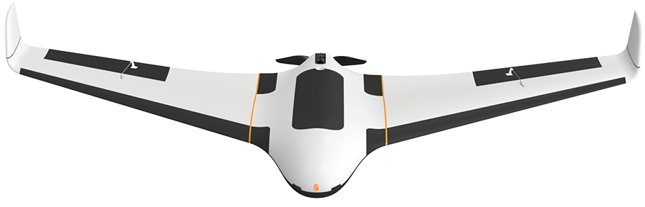

After going all this challenges, you can finally enjoy that nice beer cola with friends…
UAV wants To chat
Look at your phone

Slide 21
A little chat with UAV…
Well Lojzo that is nice story, but how is it going to help me to avoid obstacles and execute mission?
You can use same principles of preemptive and reactive obstacle avoidance in your case
Slavic magic and Vodka ?
No, we can use Mathematics (Slavic magic) and my implementation skills (Coffee) to make you safe
Like what ?
Some kind of elaborate Framework covering:
[1] Path planning, [2] Evolving world, [3] Adversarial, [4] Data fusion,
[5] Static restrictions, [6] Weather, [7] Rules

Slide 22

Obstacle Avoidance Framework

Slide 23
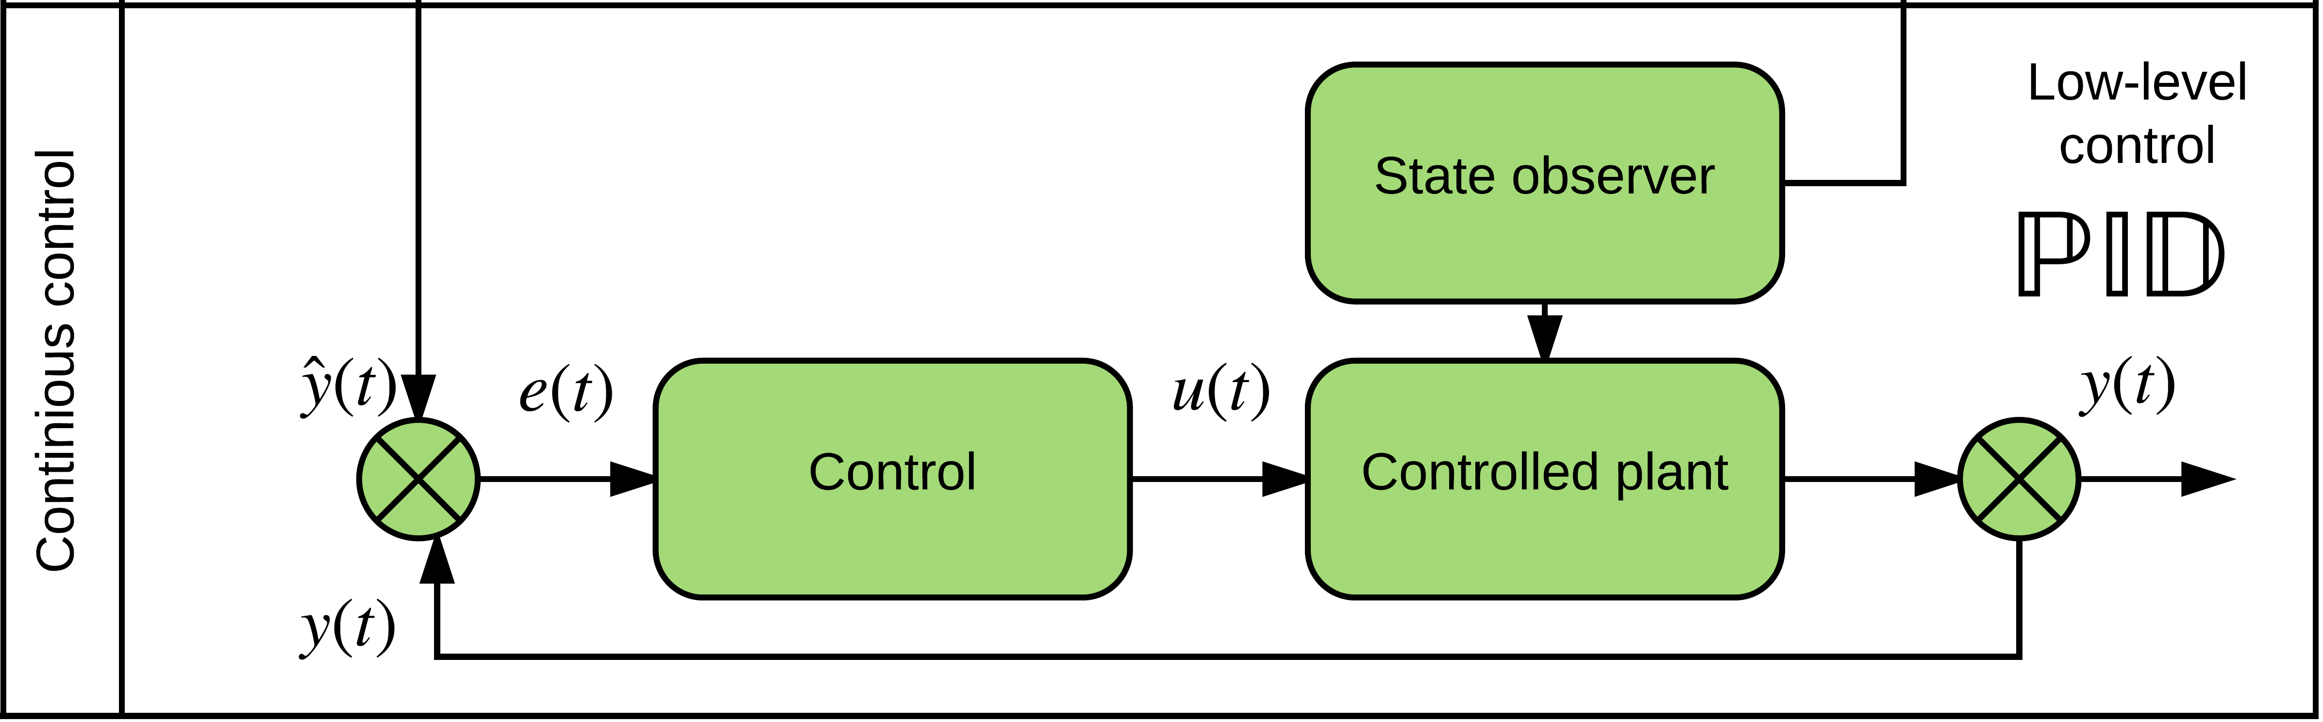
Vehicle control
ADS-B
Obstacle Map
LiDAR
Rule Engine
Data fusion
Mission Plan
Avoidance grid
Vehicle control
Movement Automaton
Reach set estimation
Notes:
Example of Vehicle control can be standard closed loop control
This has been implemented as prototype in Matlab

Slide 24
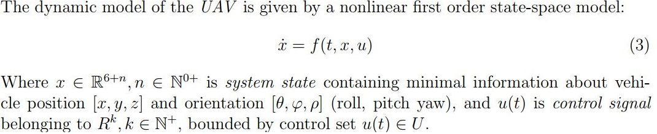
Vehicle control
You have some nice vehicle model:
Then check following conditions:
Observability of the system (Mandatory)
Controllability of the system (Optional)
Trajectory tracking control implementation (Optional)
Then you are ready to construct movement automaton

Slide 25
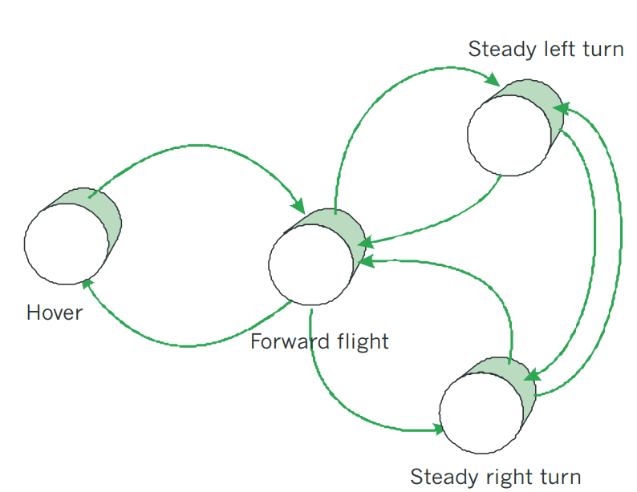
Movement Automaton
ADS-B
Obstacle Map
LiDAR
Rule Engine
Data fusion
Mission Plan
Avoidance grid
Vehicle control
Movement Automaton
Reach set estimation
Notes:
Movement automaton is interface acting between conventional control principles and discrete command chain
eg. Move left 2s, move strainght 2s

Slide 26
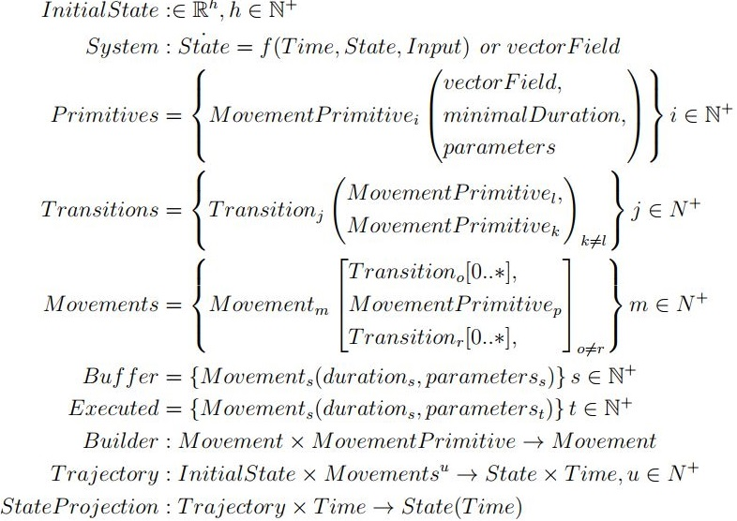
Movement Automaton, not so simple …

Slide 27
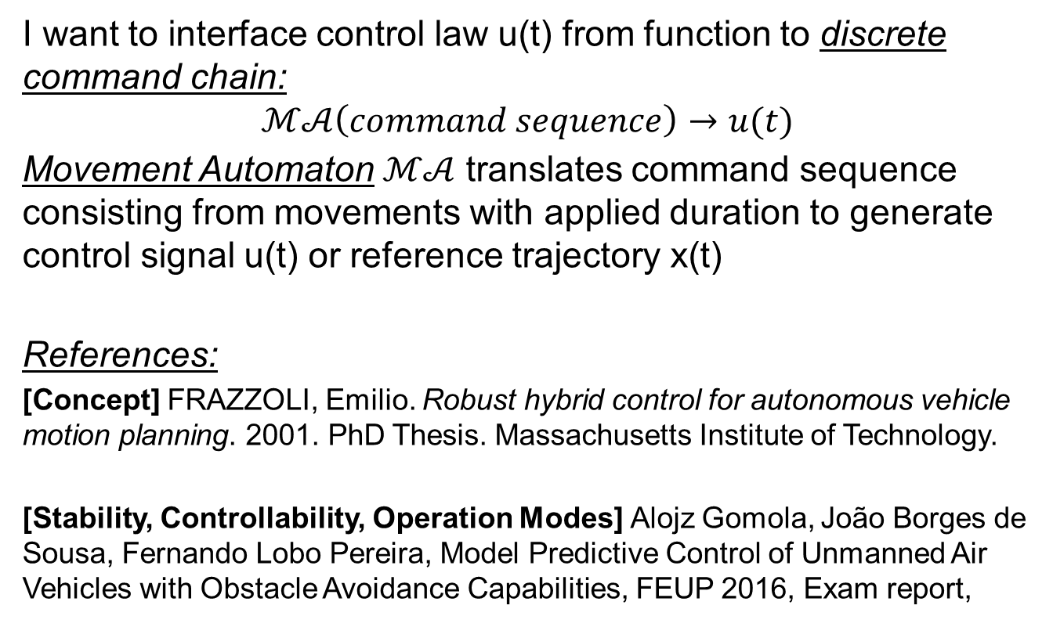
Movement Automaton, simple
I want to interface control law u(t) from function to discrete command chain:
$$ℳ𝒜\left(command sequence\right)→u(t)$$
Movement Automaton $ℳ𝒜$ translates command sequence consisting from movements with applied duration to generate control signal u(t) or reference trajectory x(t)
References:
[Concept] FRAZZOLI, Emilio. Robust hybrid control for autonomous vehicle motion planning. 2001. PhD Thesis. Massachusetts Institute of Technology.
[Stability, Controllability, Operation Modes] Alojz Gomola, João Borges de Sousa, Fernando Lobo Pereira, Model Predictive Control of Unmanned Air Vehicles with Obstacle Avoidance Capabilities, FEUP 2016, Exam report,

Slide 28
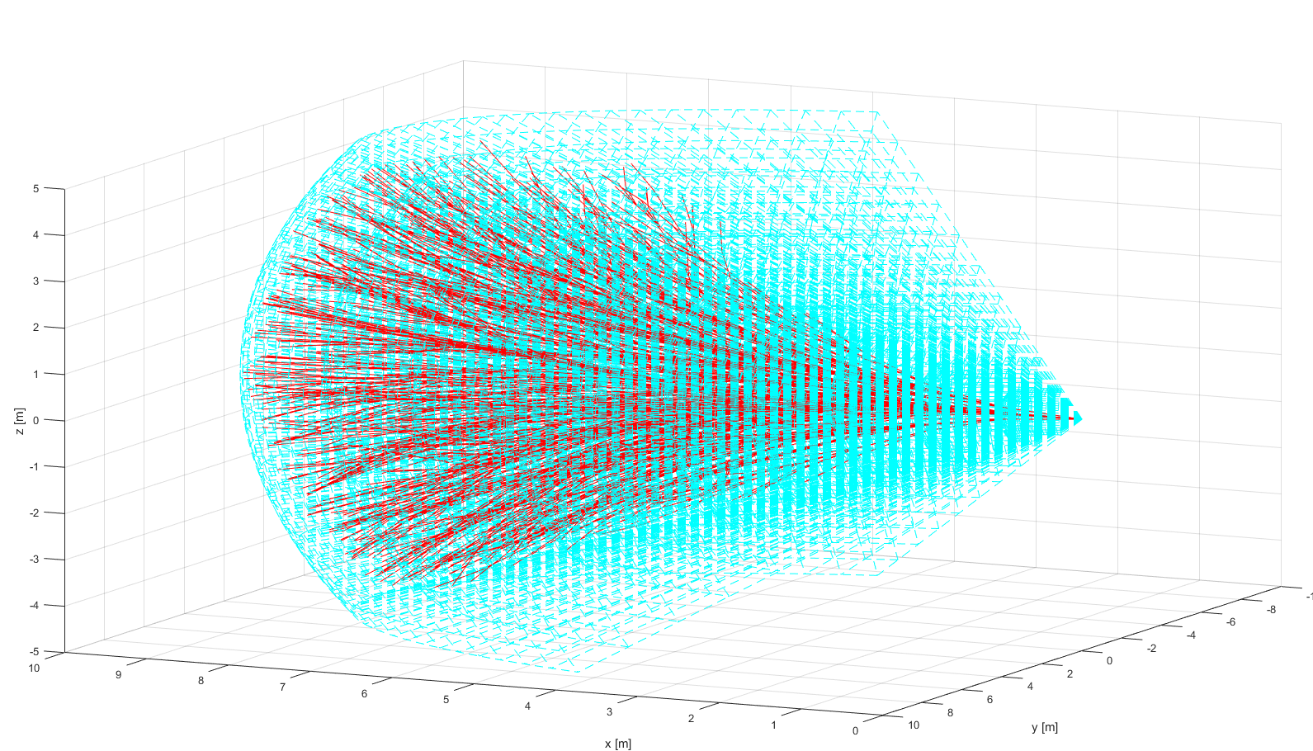
Reach set estimation
ADS-B
Obstacle Map
LiDAR
Rule Engine
Data fusion
Mission Plan
Avoidance grid
Vehicle control
Movement Automaton
Reach set estimation
Notes:
Example of reach set using my method (red) in Field of vision (aquamarine)
There has been implementation of prototype in Matlab (Deterministic version)

Slide 29
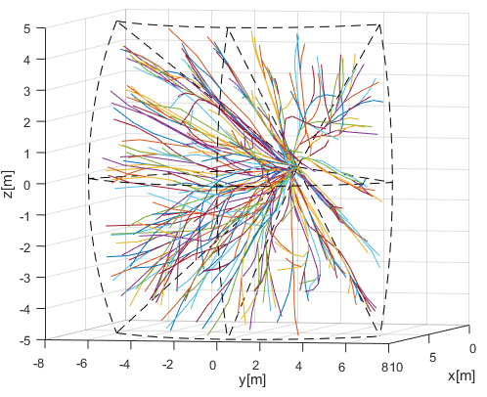
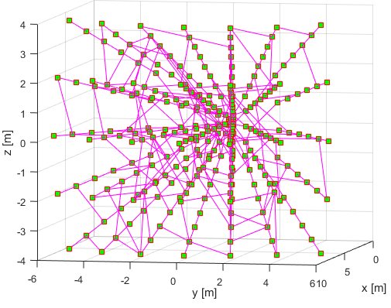
Reach set -Trajectory set & Graph
Trajectory set approximation:
1350 movements
270 paths
Graph approximation:
351 nodes
270 paths

Slide 30
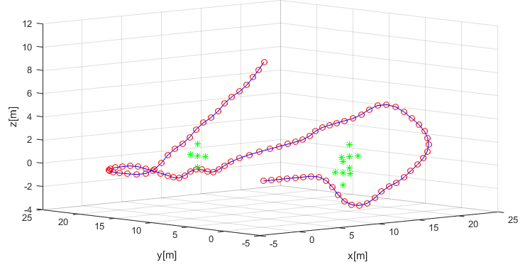
Mission plan
ADS-B
Obstacle Map
LiDAR
Rule Engine
Data fusion
Mission Plan
Avoidance grid
Vehicle control
Movement Automaton
Reach set estimation
Notes:
Example of simple mission with 4 waypoints, implemented as Matlab simulation

Slide 31
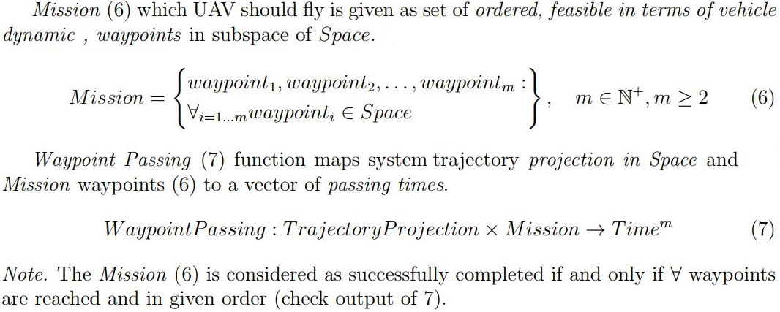
Some mathematical background:
What you need ?
Define mission as sequence of waypoints
Define waypoint passing condition to evaluate performance,

Slide 32
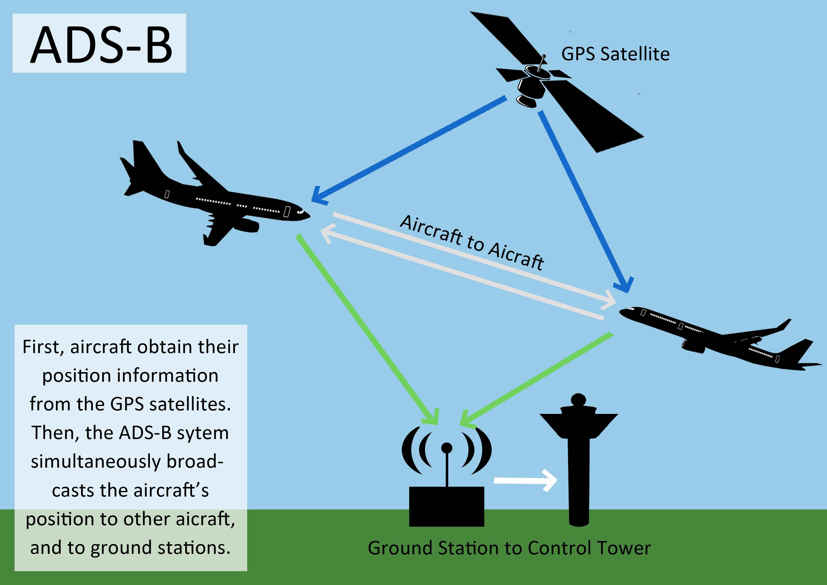
ADS-B
ADS-B
Obstacle Map
LiDAR
ADS-B
Rule Engine
Data fusion
Mission Plan
Avoidance grid
Vehicle control
Movement Automaton
Reach set estimation
Notes:
Here is an example of ADS-B

Slide 33
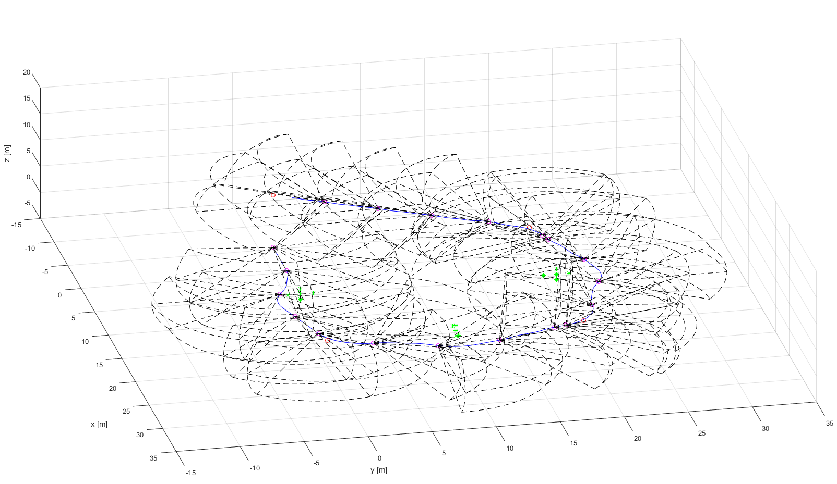
LiDAR
ADS-B
Obstacle Map
LiDAR
Rule Engine
Data fusion
Mission Plan
Avoidance grid
Vehicle control
Movement Automaton
Reach set estimation
Notes:
In the picture you can see example of Flash Lidar scanned area over trajectory

Slide 34
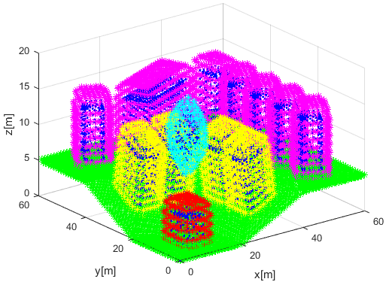
Obstacle Map
Obstacle Map
ADS-B
Obstacle Map
LiDAR
Rule Engine
Data fusion
Mission Plan
Avoidance grid
Vehicle control
Movement Automaton
Reach set estimation
Notes:
Here is example of cuboid coatings (dark blue) with virtual convex coating (magenta, cyan, yellow, red)

Slide 35
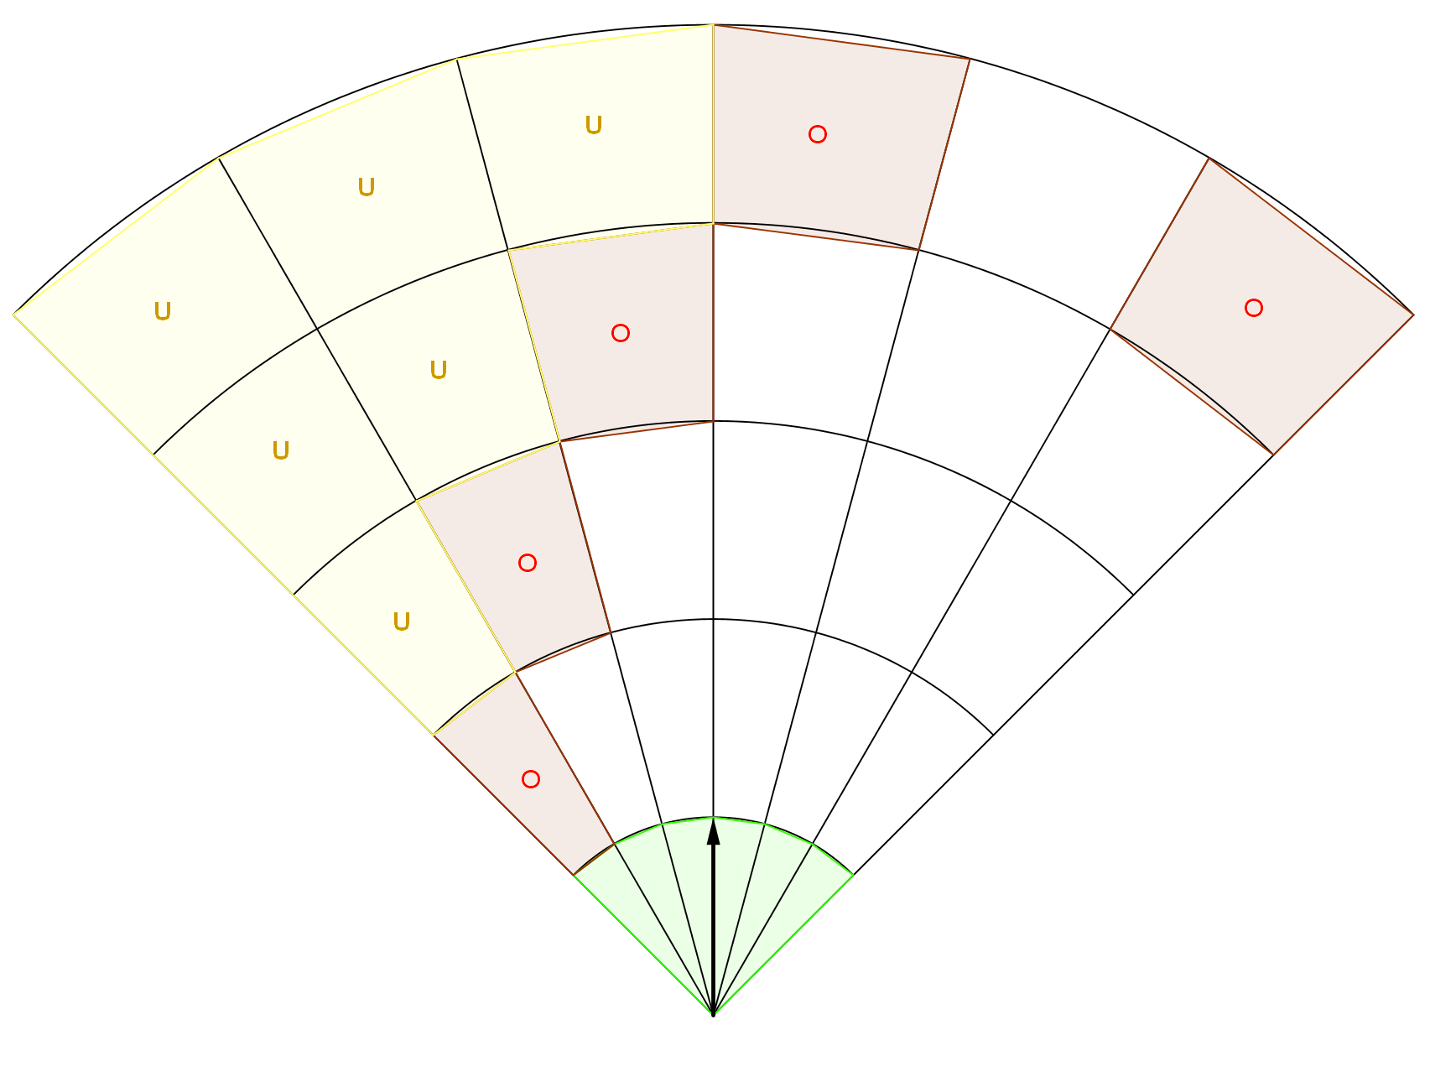
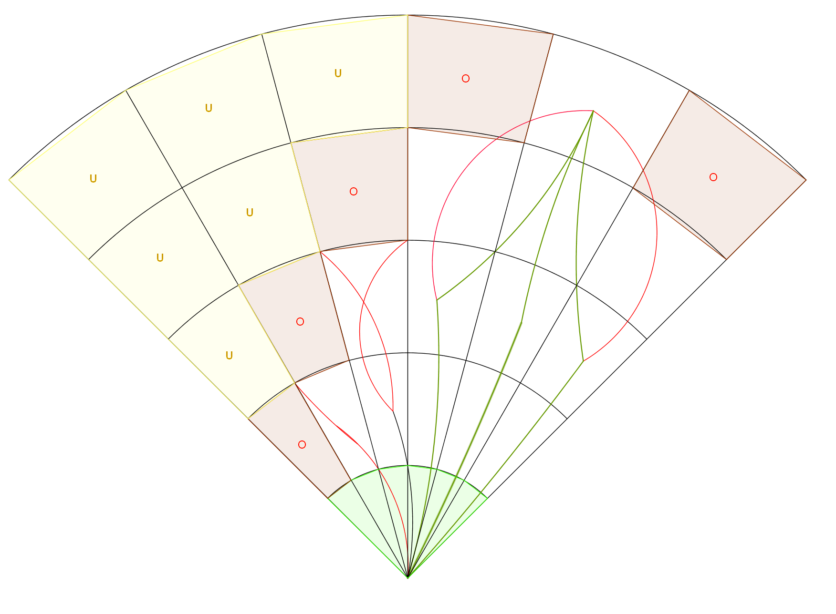
Avoidance Grid
ADS-B
Obstacle Map
LiDAR
Rule Engine
Data fusion
Mission Plan
Avoidance grid
Vehicle control
Movement Automaton
Reach set estimation
Notes:
Reach set is blended and pruned in avoidance grid , giving us estimation of reachable set in constrained space

Slide 36
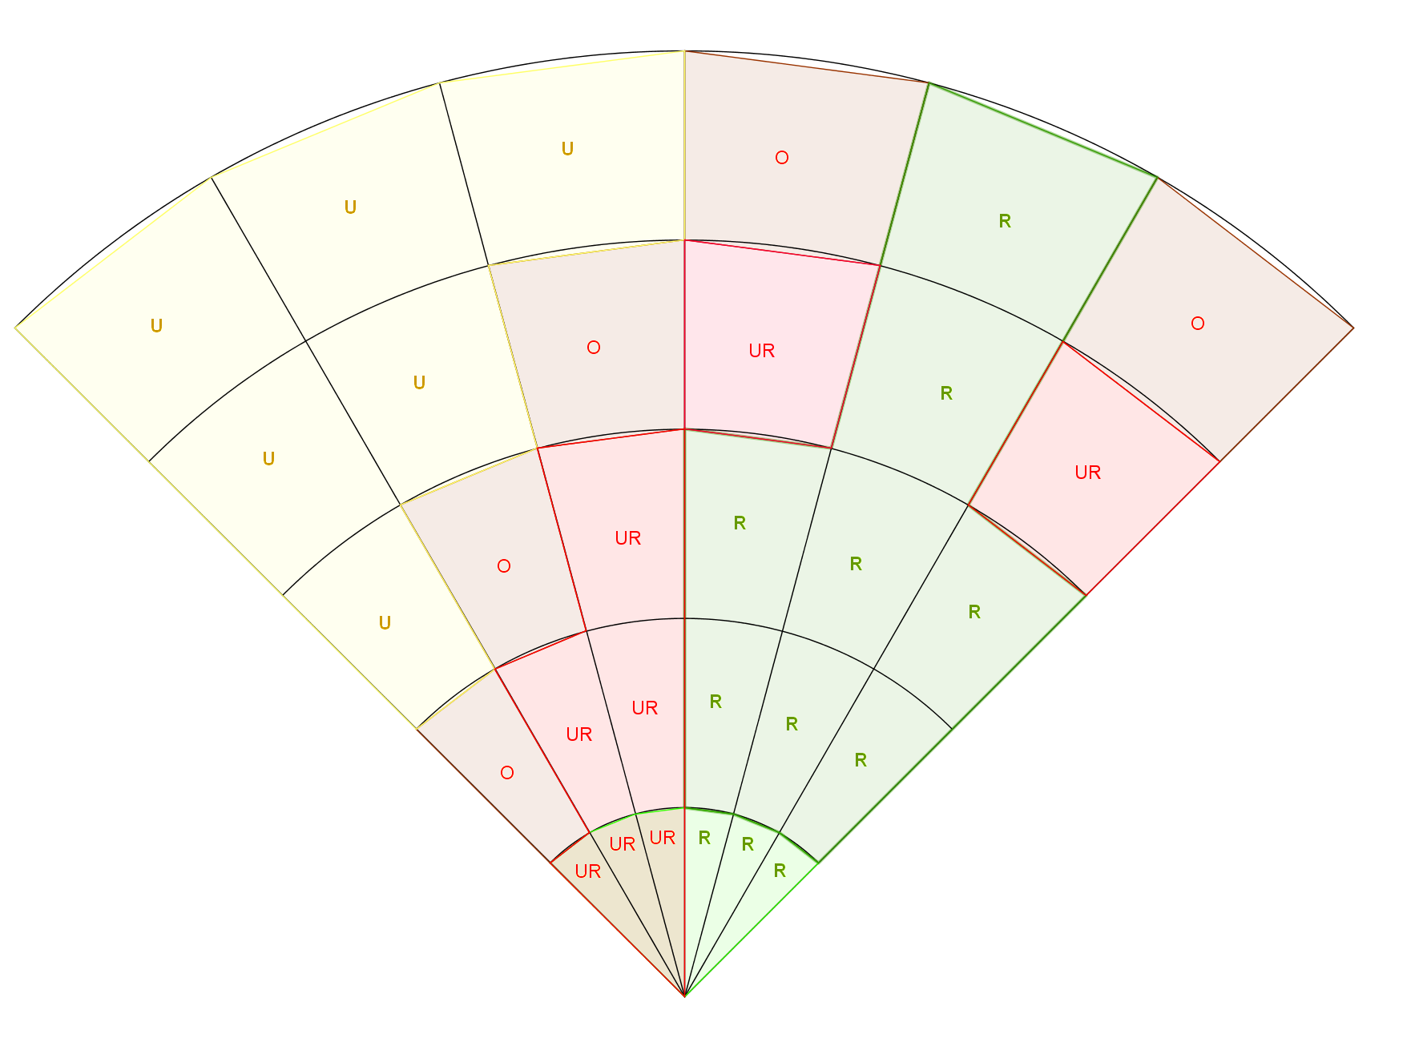
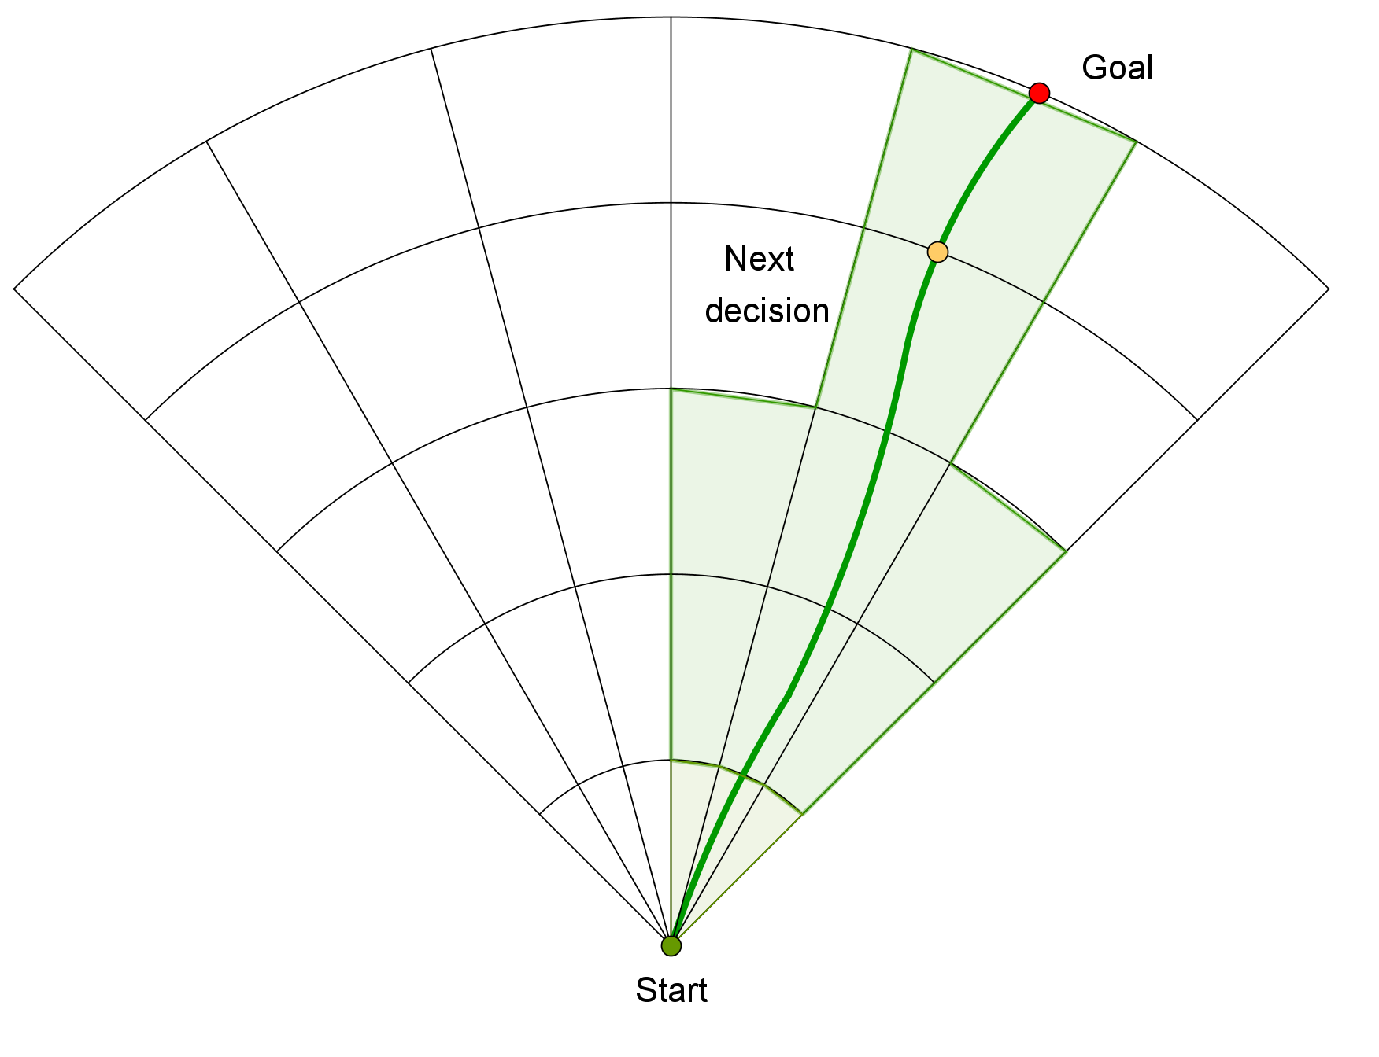
Avoidance Grid
ADS-B
Obstacle Map
LiDAR
Rule Engine
Data fusion
Mission Plan
Avoidance grid
Vehicle control
Movement Automaton
Reach set estimation
Notes:
Rule engine then selects goal of avoidance and Next decision point (There is primitive hard-coded set of rules)
Avoidance grid have been fully implemented and tested for simple plane model in Matlab

Slide 37
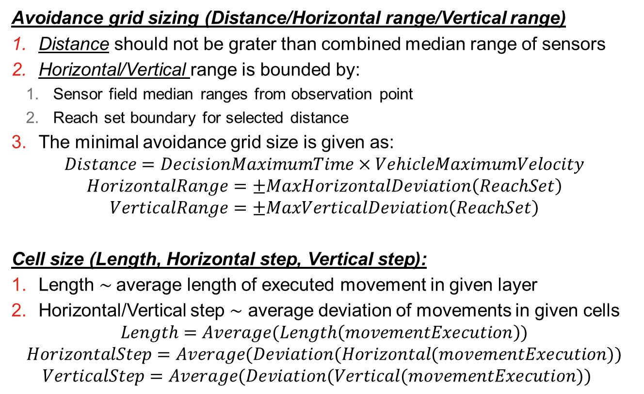
Conditions
Avoidance grid sizing (Distance/Horizontal range/Vertical range)
Distance should not be grater than combined median range of sensors
Horizontal/Vertical range is bounded by:
Sensor field median ranges from observation point
Reach set boundary for selected distance
The minimal avoidance grid size is given as:
$$Distance=DecisionMaximumTime×VehicleMaximumVelocity$$
$$HorizontalRange=±MaxHorizontalDeviation\left(ReachSet\right)$$
$$VerticalRange=±MaxVerticalDeviation\left(ReachSet\right)$$
Cell size (Length, Horizontal step, Vertical step):
Length $∼$average length of executed movement in given layer
Horizontal/Vertical step $∼$ average deviation of movements in given cells
$$Length=Average(Length\left(movementExecution\right))$$
$$HorizontalStep=Average(Deviation(Horizontal(movementExecution))$$
$$VerticalStep=Average(Deviation(Vertical(movementExecution))$$

Slide 38
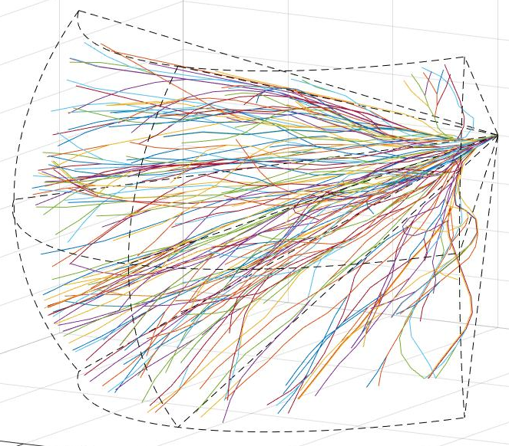
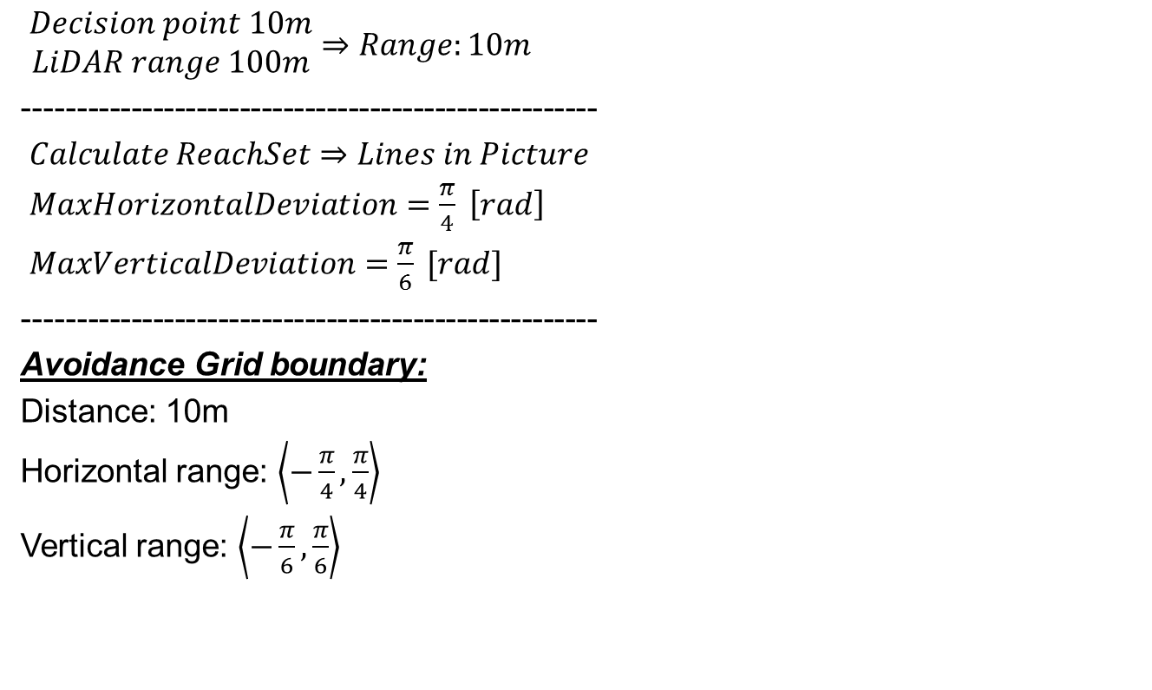
Example: Grid Scaling
$\begin{matrix}Decision point 10m \\ LiDAR range 100m\end{matrix}⇒Range:10m$
-----------------------------------------------------
$Calculate ReachSet⇒Lines in Picture$
$MaxHorizontalDeviation=\frac{π}{4} \left[rad\right]$
$MaxVerticalDeviation=\frac{π}{6} [rad]$
-----------------------------------------------------
Avoidance Grid boundary:
Distance: 10m
Horizontal range: $\left\langle −\frac{π}{4},\frac{π}{4}\right\rangle$
Vertical range: $\left\langle −\frac{π}{6},\frac{π}{6}\right\rangle$

Slide 39

Framework Summary
You should check my article: GOMOLA, Alojz, et al. Obstacle Avoidance Framework Based on Reach Sets. In: Iberian Robotics conference. Springer, Cham, 2017. p. 768-779.
Key notes:
Movement Automaton – interface between control and avoidance grid,
Sensor/Data Fusion – interface between sensors/information sources and avoidance grid,
Reach set – tells UAV where it can go from initial position with given maneuvering capabilities from Movement Automaton
Avoidance grid – combines known world from Sensor/Data Fusion with Reach set for current vehicle state and applies Rules to find best escape trajectory in Field of Vision,
Rule engine – contains set of Rules,
Addressed issues:
[1] Path planning, [2] Evolving world, [3] Adversarial, [4] Data fusion

Slide 40

Some Results …

Slide 41
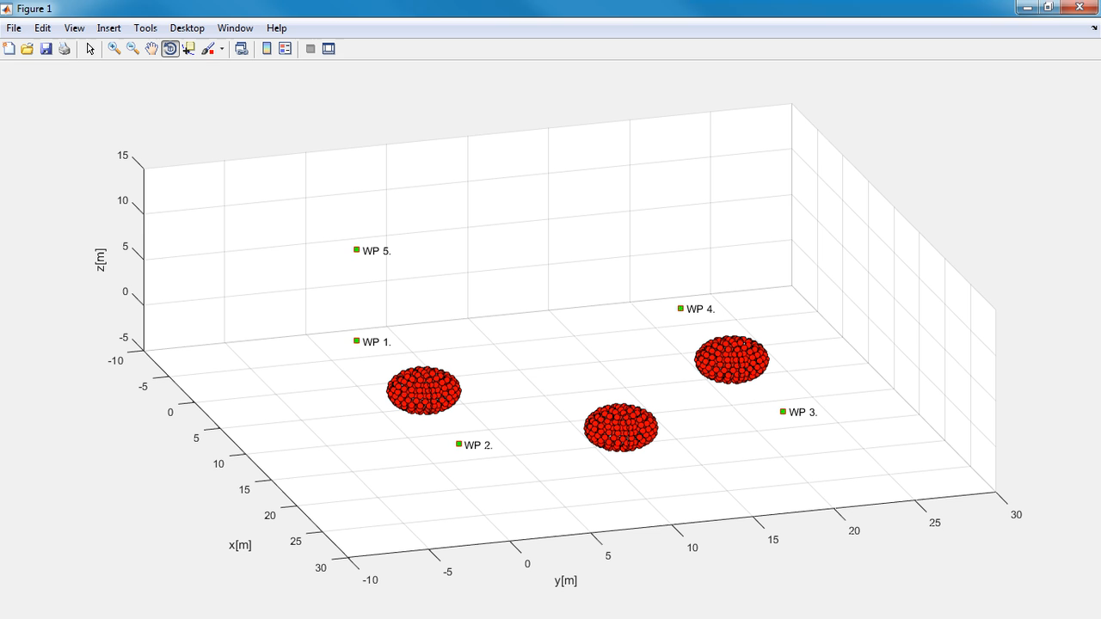
Static obstacle avoidance

Slide 42
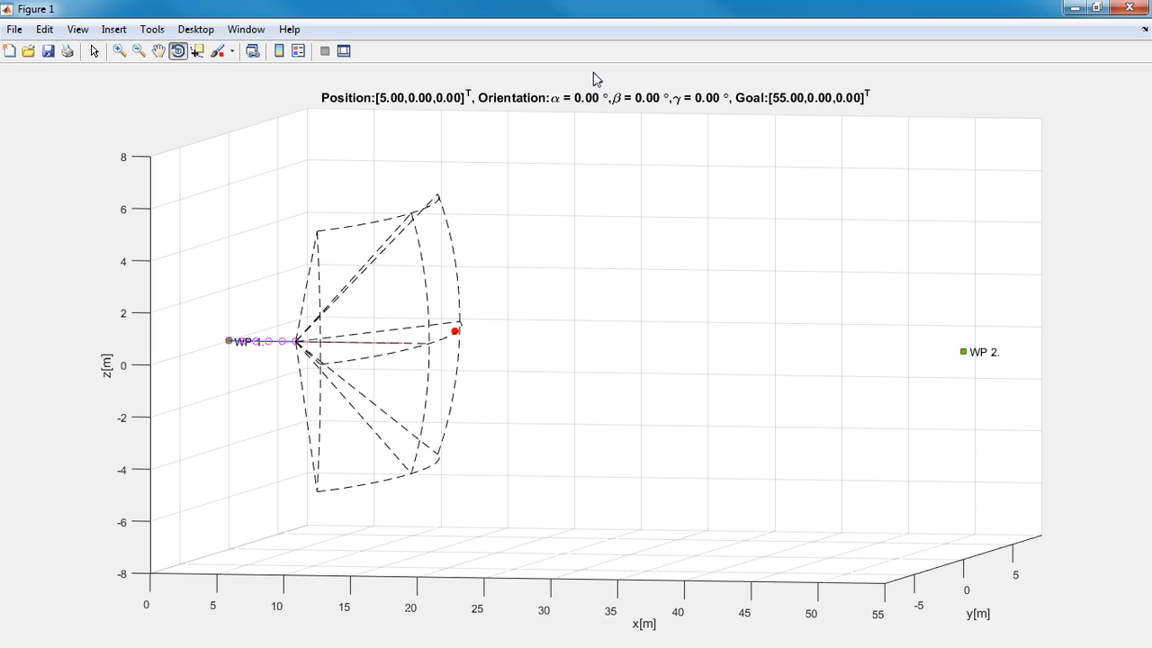
Intruders avoidance

Slide 43

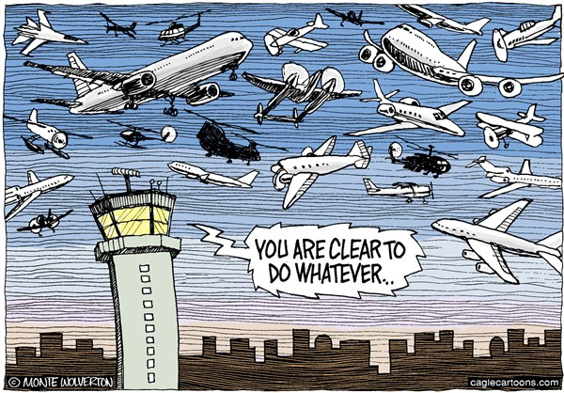


Actual Challenges
Weather
ATC

Slide 44
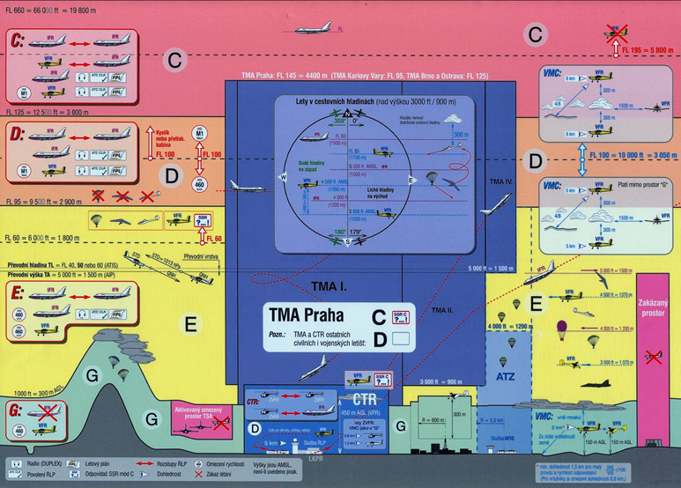
Airspace classification
We want to Fly in Non-Segregated Airspace
Space is separated into levels defined by boundaries:
Level C-F – altitude in Flight Levels (FL)
Level G – altitude in Above Ground Level (AGL)
Example of European Airspace classification
(Czech republic)
Next slide

Slide 45
Airspace classification (Detail)

Slide 46
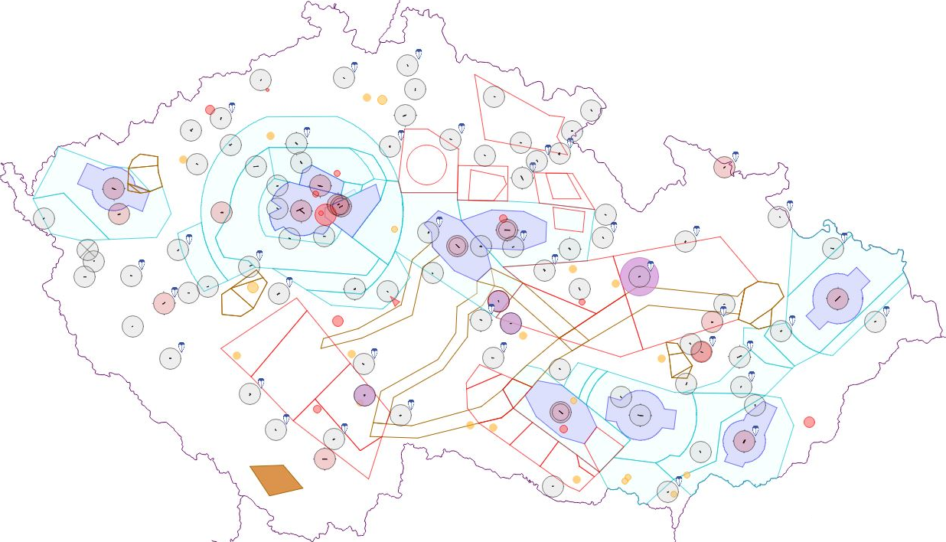
ATC constraints – Czech Republic
Example of air traffic constraints is taken from Czech national air traffic control portal (http://aisview.rlp.cz/)
Airport
Control zone
Temporary area

Slide 47
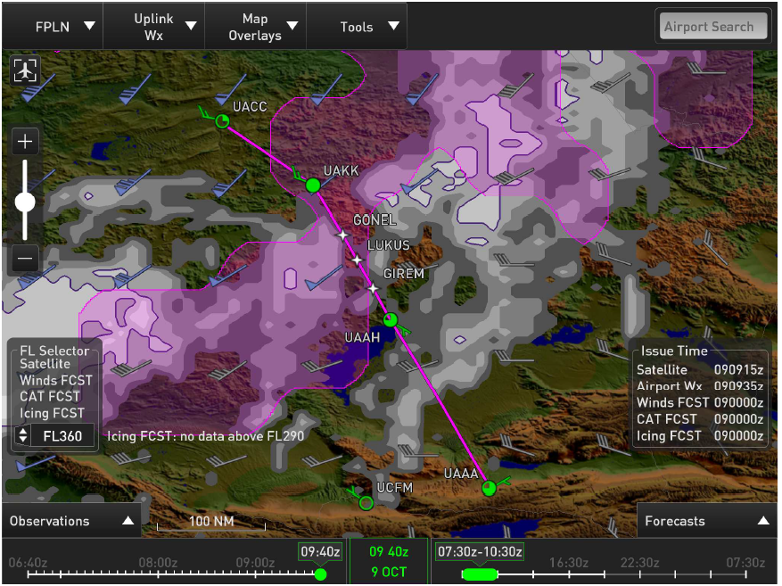
Weather constraints
UAV system in general is more sensitive to weather conditions than standard manned aviation (icing, storms, turbulences)
Clouds can generally render UAV sensing system
Especially thick fog renders LiDAR sensor range tremendously
Modern manned aviation system can provide data necessary for weather situations avoidance
Example of advanced weather warning system developed by Honeywell.
Extracted data will be used as a source of restrictions for UAV

Slide 48
Intruder avoidance priority
Our vision is based on various projects:
Amazon Drone platform – fully autonomous UAV
NASA – UTM (UAV Traffic Management) – rules in development
JARUS – SAA regulation framework (in development)
The rules of the air are formulated (ICAO annex II.) around avoidance priority, depending on technical capabilities of manned aircraft type (Jumbo jet should avoid glider due higher maneuverability).
The expected behavior of UAV platform is given by following table:
Intruder | Our vehicle | Priority
Manned aircraft | Any UAV | Manned aircraft
VLOS piloted UAV | VLOS piloted UAV | Coordinated avoidance
VLOS piloted UAV | Autonomous UAV | Autonomous UAV
Autonomous UAV | Autonomous UAV | Coordinated avoidance

Slide 49
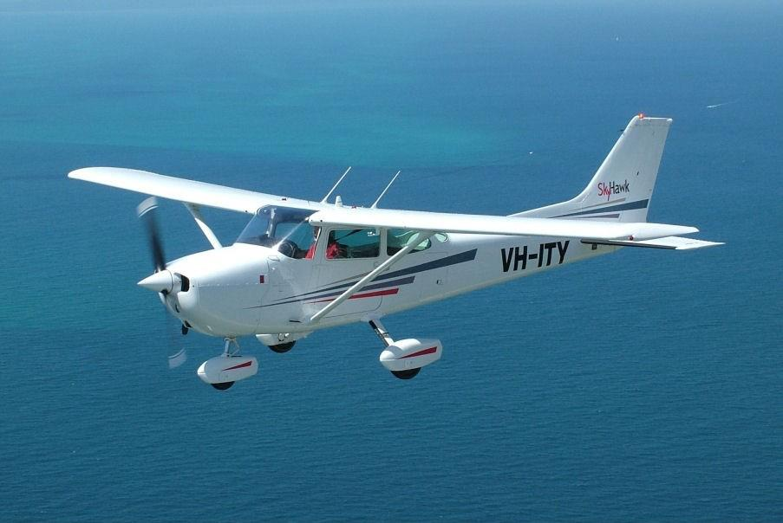
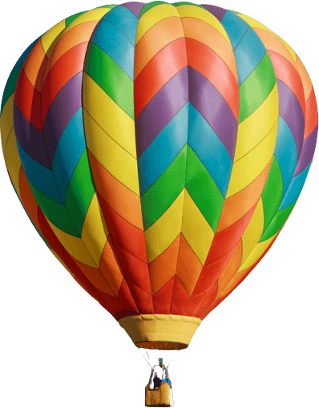
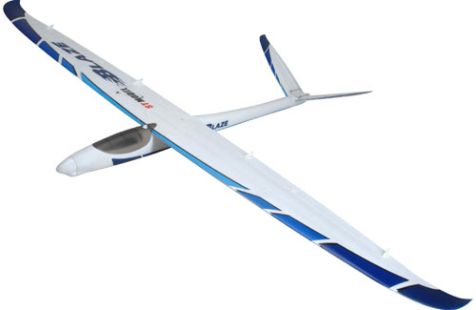
Aviation classes for immediate avoidance
FIRST: Manned aviation in distress
SECOND Balloons THIRD Gliders
Mayday, mayday, mayday!
For more Information: ICAO ANNEX II.

Slide 50
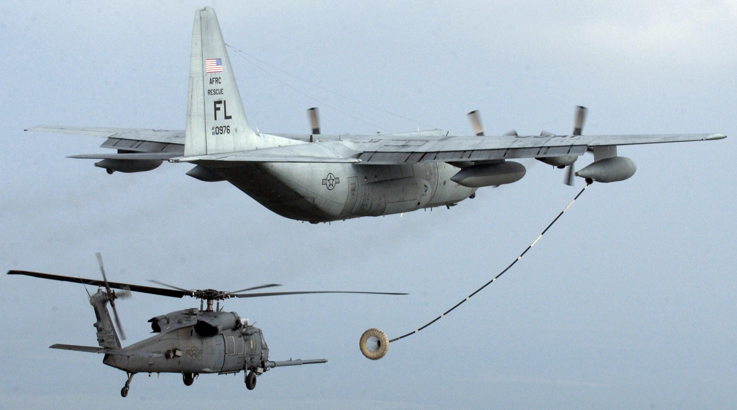
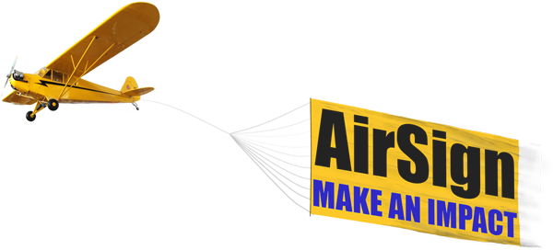
Aviation classes for immediate avoidance
FOURTH: Aerial fueling and towing
Fueling of aircraft
Towing a sign, aircraft or other dependable load

Slide 51
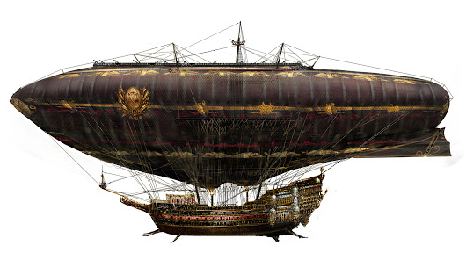
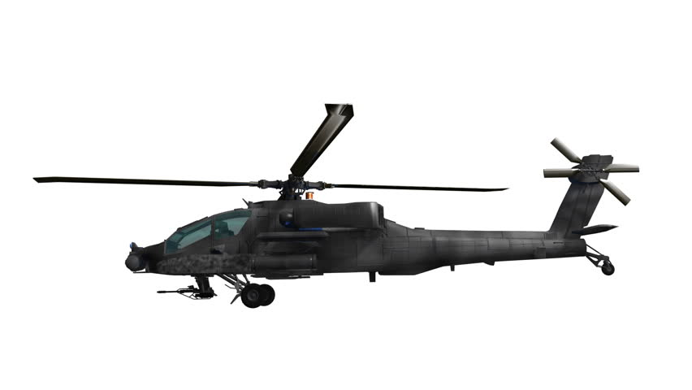
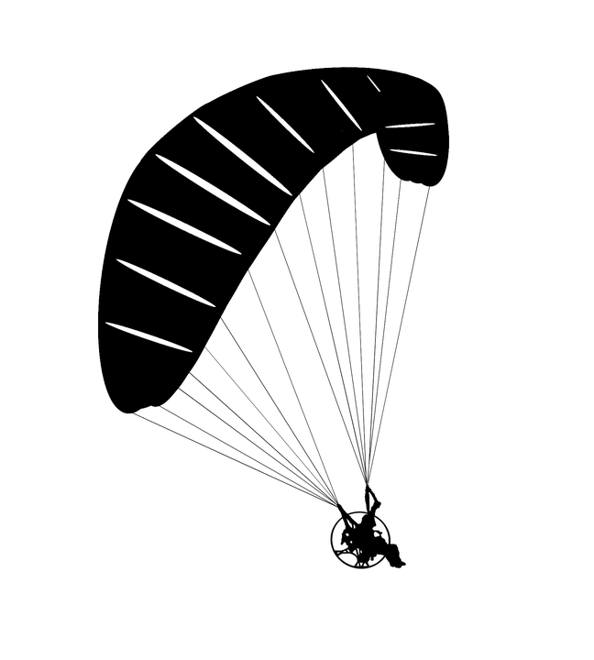
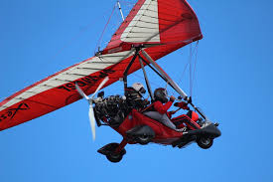
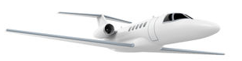
Aviation classes for immediate avoidance
FIFTH: Airships
Sixth: Manned aviation with propeller
But Lojzo, I am not on this list…
You are here on the bottom of course
Pilots don`t like you, you need to avoid all manned aviation

Slide 52



Proposed unmanned aviation classes
Seventh: Unmanned aviation with standardized avoidance system
Eight: Unmanned aviation for VLOS operations piloted from ground
Aww thanks buddy !
No problem mate!
That was sarcastic…

Slide 53
Right of the way rules
Right of the way rules aid pilots in avoiding each other visually
The rules are found:
Part 91 Federal Aviation Regulation (USA)
ICAO Annex 2 -> Chapter 3 - General Rules -> 3.2 Avoidance of collisions -> 3.2.2 Right of way (International)
When aircrafts are converging, the right of way is generally given to the least maneuverable aircraft (higher class)
The aircraft now having the right of the way is to pass well clear of the aircraft not having the right of the way
Application for rules of the air in case of UAV seems to be reduced to immediate avoidance in case of manned aviation adversary
The avoidance rules can be applied between the same class of UAV

Slide 54


Converging aircrafts of the same category
$$α≥{70}^{o}$$
The aircraft on other right, has the right of the way

Slide 55
Converging aircrafts of the same category

Slide 56
Converging aircrafts of the same category
The aircraft on other right, hast the right of the way
Turn right and stay away from approaching aircraft

Slide 57
Converging aircrafts of the same category
Return to original path behind other aircraft

Slide 58
Overtaking aircraft of the same category
Lower speed aircraft is being overtaken

Slide 59
Overtaking aircraft of the same category
The aircraft being overtaken has the right of the way

Slide 60
Overtaking aircraft of the same category
Overtake is executed from right

Slide 61

Overtaking aircraft of the same category
Overtake rule apply also for convergence under ${α<70}^{o}$

Slide 62



Head on approach of same category
$$α≥{130}^{o}$$
$$r≥s_{m}$$
Applies when angle of approach $α≥{130}^{o}$, Safety margin $s_{m}$ must be defined

Slide 63
Head on approach of same category
Both vehicles are taking right side avoidance

Slide 64

Summary - Right of the way
Manned aviation defines only horizontal avoidance, vertical avoidance is considered in TCAS, horizontal avoidance will be added in ACAS-Xu
Manned aviation does not define angle of approach $α$ strictly, it is usually used following margins:
${180}^{o}≥α≥{130}^{o}$ Head on avoidance (both avoiding)
${130}^{o}>α≥{70}^{o}$ Covering avoidance (the left avoiding)
$α<{70}^{o}$ Overtake (faster avoiding)
Safety margin $s_{m}$ for Head on avoidance is defined as sufficient distance to avoid vehicle induced turbulence or obstruction of airflow, in case of UAV it must be defined based on UAV class size (bigger UAV), this can induce additional problems
Overall “rules of air” and “right of the way” should be amended to be compatible with UAV integration into non-segregated airspace
Pilot judgement is always the main consideration, therefore manned aviation behavior is unpredictable to some extent

Slide 65
Last chat with UAV
Well Lojzo I see there is still a lot of challenges, to make me safe….
But when will be this feasible ?
Our Framework is already covering:
[1] Path planning, [2] Evolving world, [3] Adversarial, [4] Data fusion,
[5] Static restrictions (somehow)
Now we are working on:
[6] Weather, [7] Rules
That seems all nice, when I learn proper manners and add my crafty skills to avoid [6] Weather, I can finally fulfill my destiny:
To be useful for society
Well my friend it will take a lot of effort, but I will do my best to help you, At least on theoretical level, then you can fulfill your destiny:
Deliver me that Pizza

Slide 66
Summary
Computational feasibility:
Proposed method is computationally feasible, because its using only simplistic intersection and pruning algorithms for Reach Set estimation in bounded Avoidance Grid
Full Reach set can be precomputed for finite number of initial states
Provided checks and functionality:
Checking system dynamic/static constraints with finite precision
Checking environment dynamic/static constraints
Prediction of feasible trajectory in limited space
Selection of optimal trajectory in limited space
Planned checks and functionality:
Weather Flight restriction zones avoidance
Rules of the air implementation

Slide 67




Q&A Session

